Slide 1
Value Proposition Canvas

Slide 2
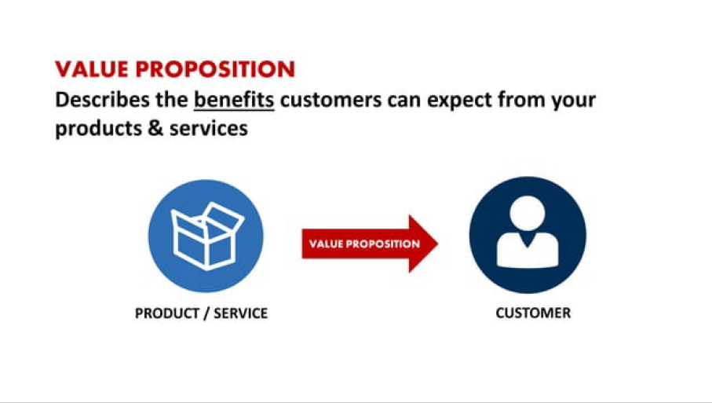
Value Proposition Canvas is a business model tool that helps you make sure that a company’s product or service is positioned around customers’ values and needs. The tool has been created by Alexander Osterwalder, Yves Pigneur, and Alan Smith.
In few words, this tool comes to facilitate the job of putting yourself in your customers’ shoes and understanding their world.

Slide 3
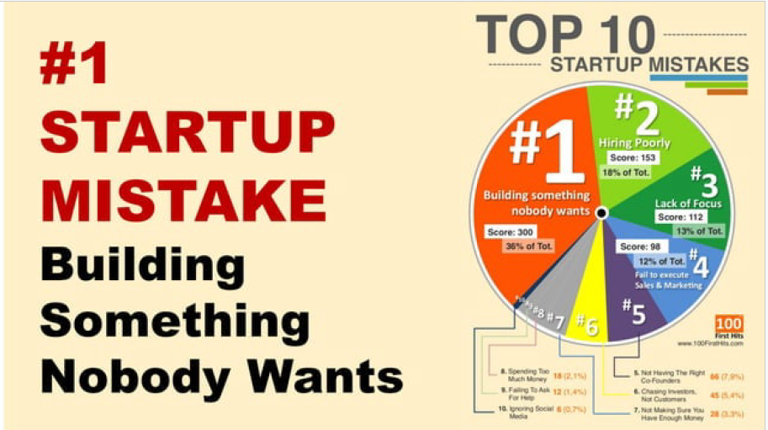

Slide 4
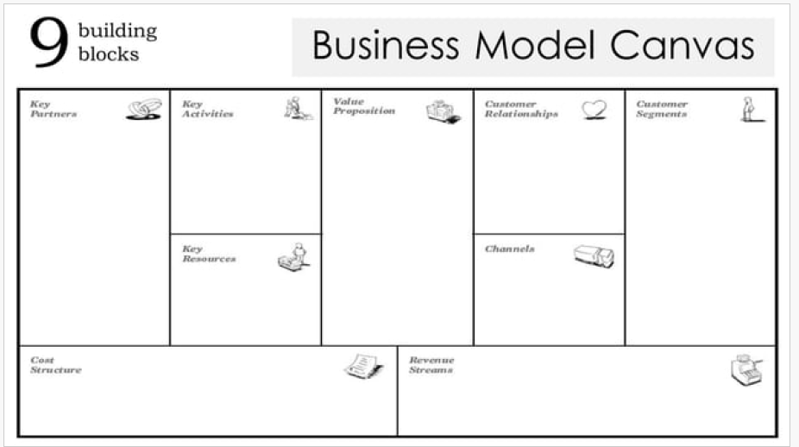
The BMC gives you a holistic overview of your entire business model,
The Business Model Canvas covers a wider scope, encompassing all elements of the business model. – It is often used for strategic planning and business model innovation.

Slide 5
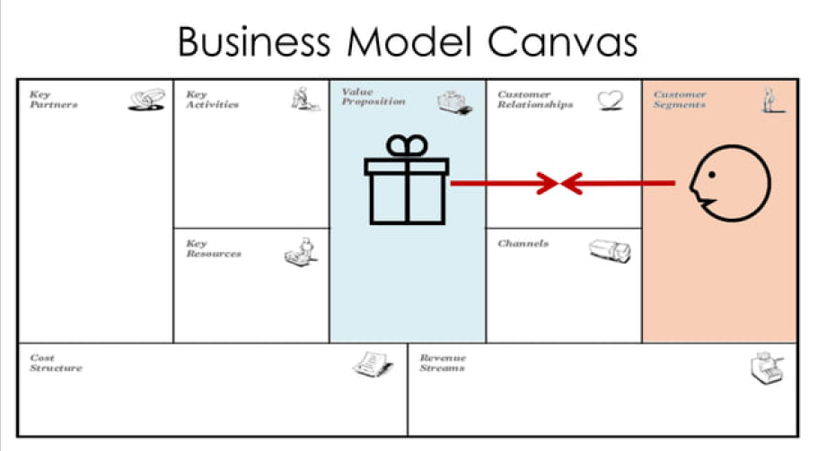

Slide 6
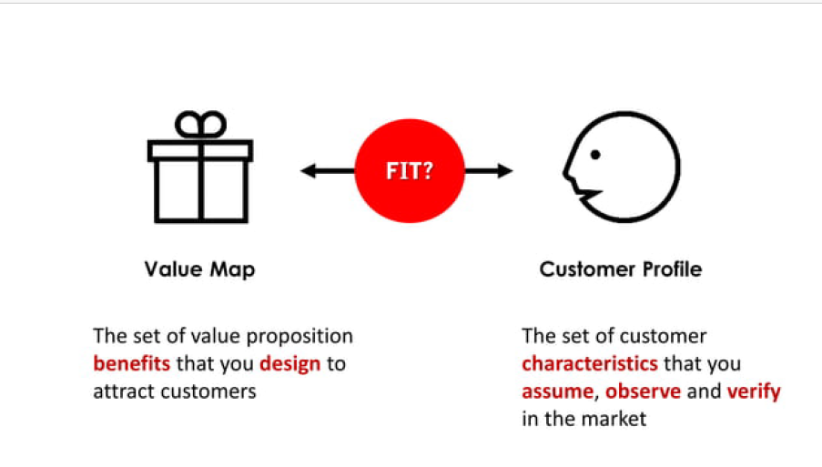
VPC zooms in on the specific value proposition that you offer to a specific customer segment.

Slide 7
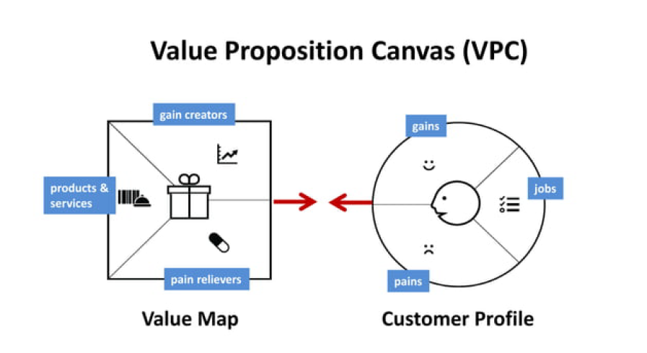
Value Proposition Canvas is made up of only two blocks – Value Proposition and Customer Segment. They are the core of the business model because they focus on “What” and “To whom”. In other words, how your company delivers value to your audience.

Slide 8
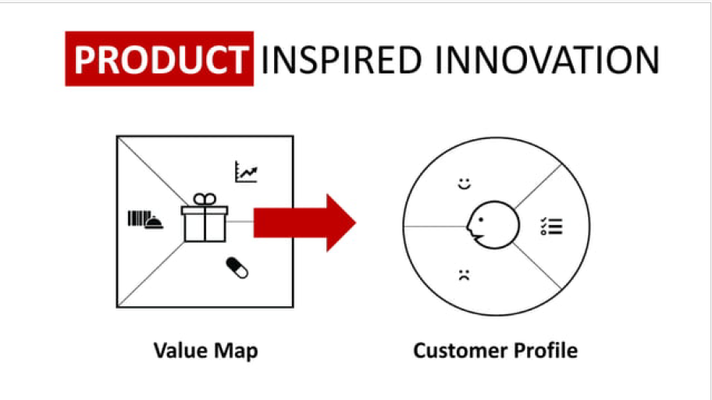

Slide 9
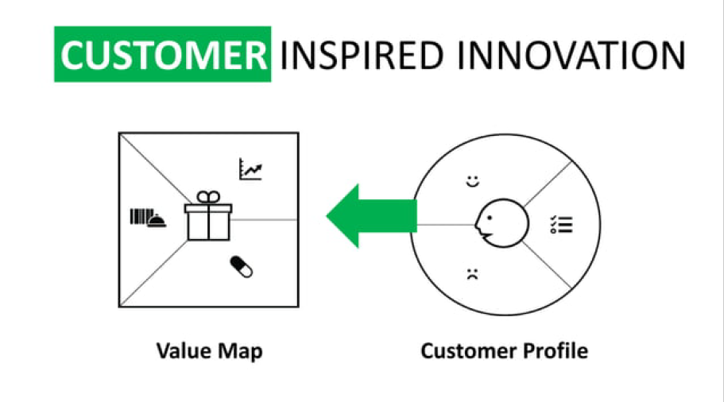

Slide 10
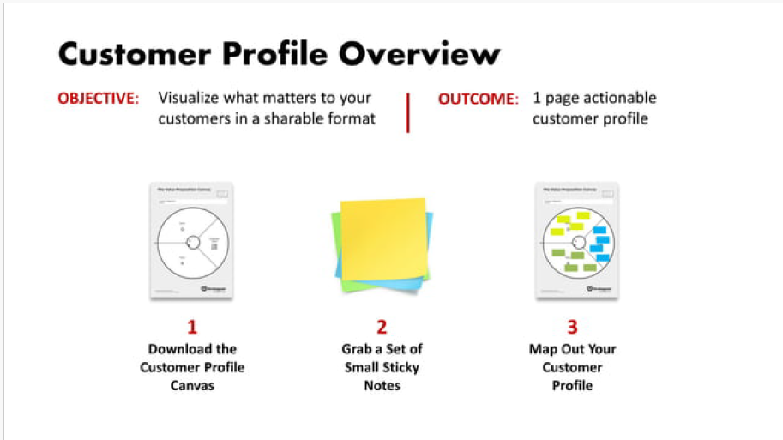

Slide 11
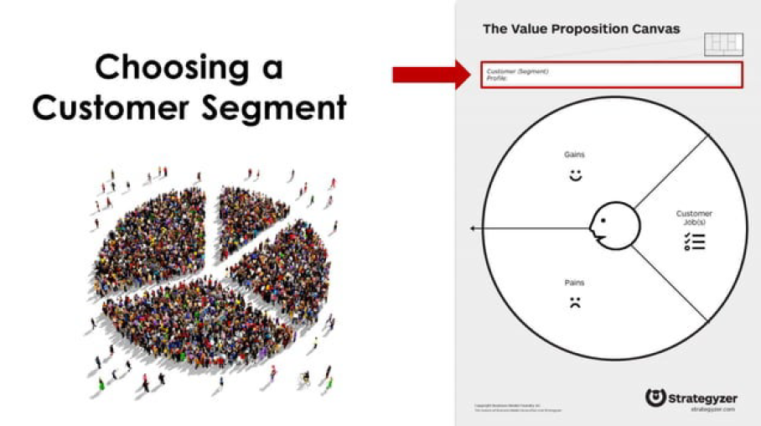

Slide 12
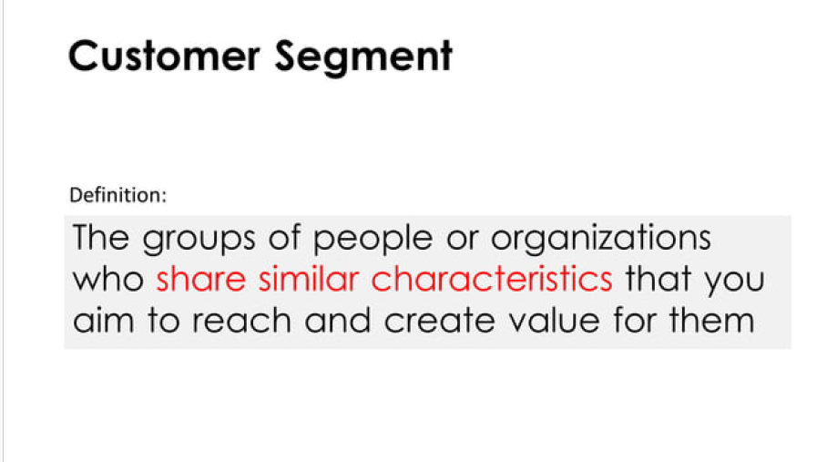

Slide 13
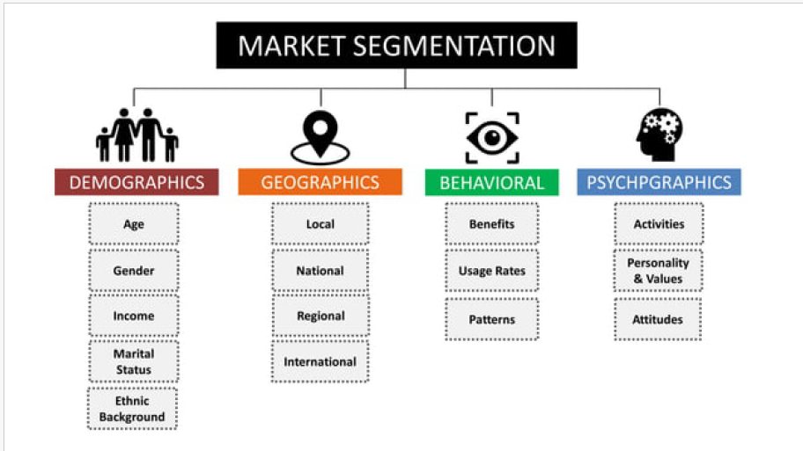

Slide 14
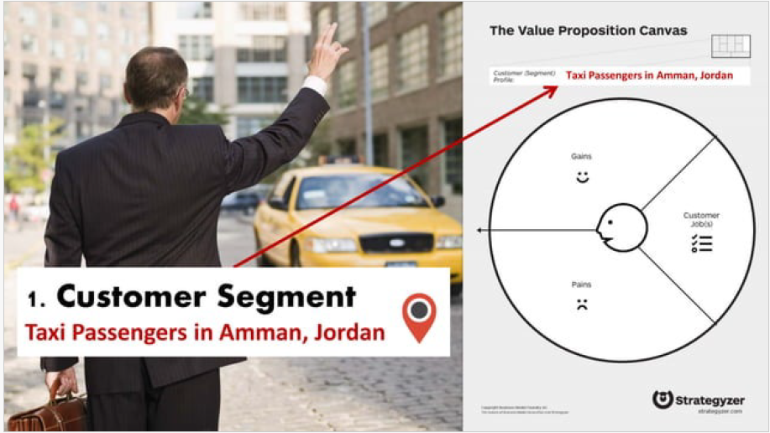

Slide 15
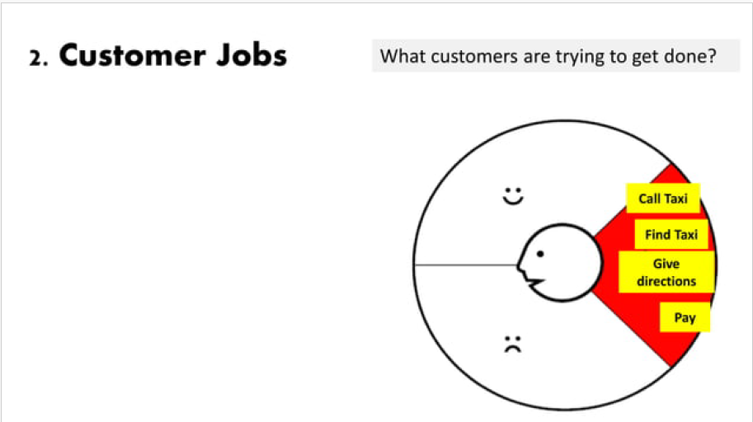
This is about what your customer is trying to do. You have to include all tasks customers are trying to perform, the problems they are trying to solve, and the needs they want to satisfy.
To fulfill this step, you may ask yourself:
What functional task, social task, emotional task is my customer trying to perform or accomplish?
What basic needs do they need/want to have satisfied

Slide 16
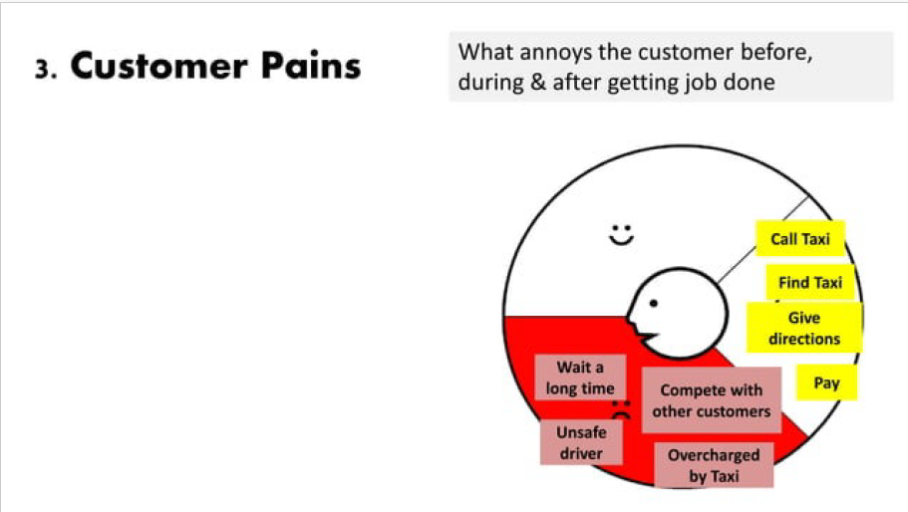
This one encompasses everything that annoys your customer while they are performing their jobs-to-be-done, such as negative experiences and emotions, challenges, risks involved, financial costs, mistakes, and consequences, etc.

Slide 17
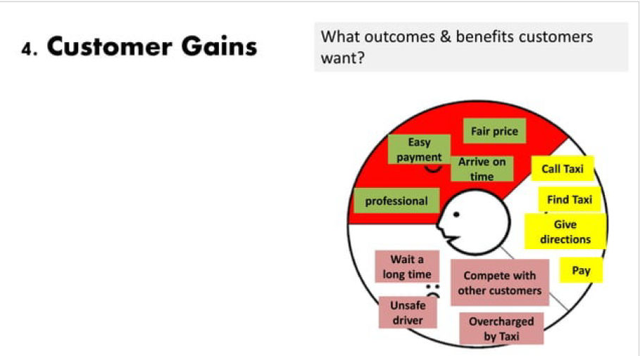
They are all the benefits your customer expects or wishes – or even something that would surprise them positively –, whether they are functional, emotional, social or financial. In short, everything that delight them and make their life easier, more joyful or more successful.

Slide 18
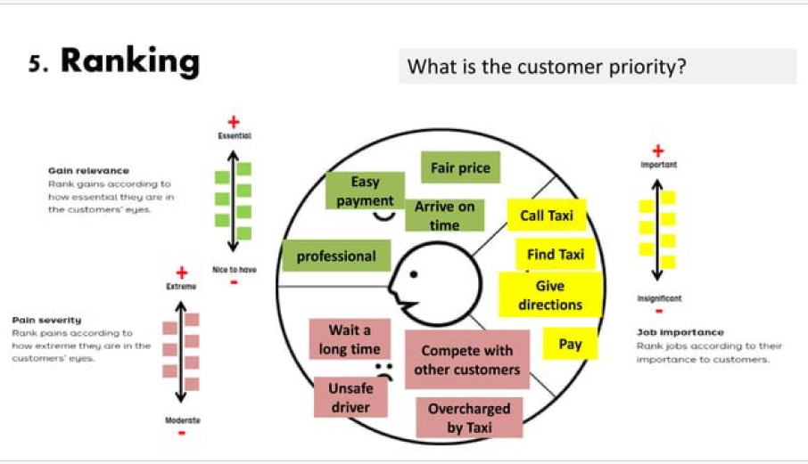

Slide 19
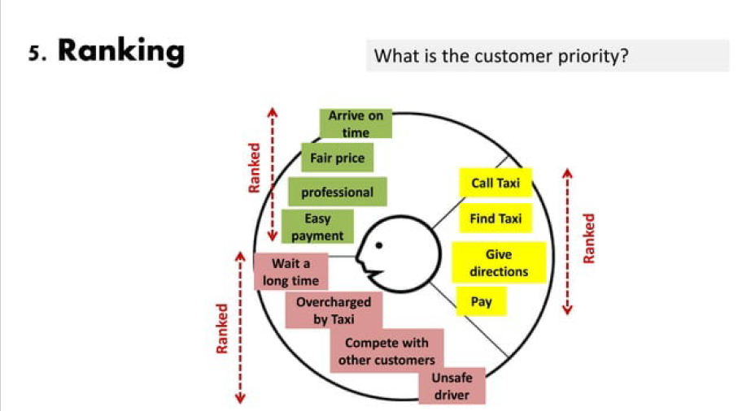

Slide 20
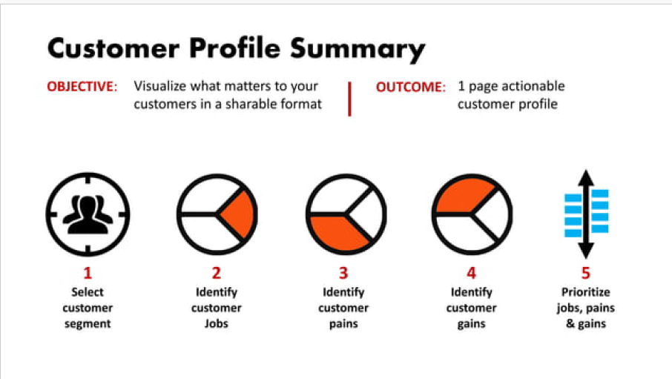

Slide 21
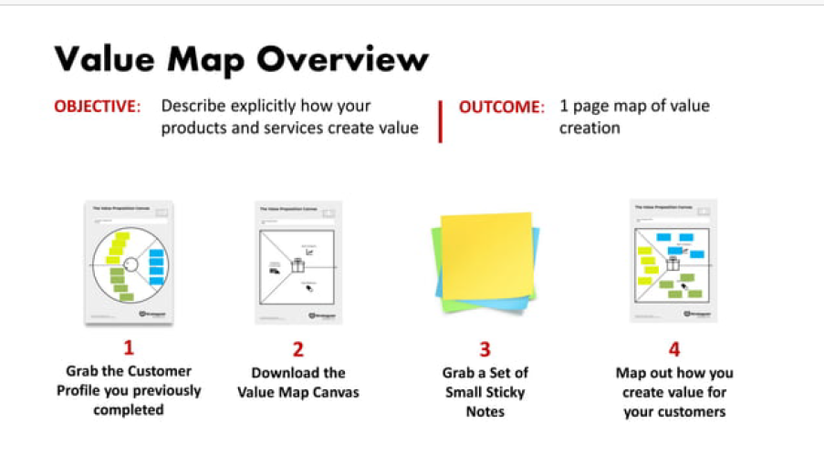

Slide 22
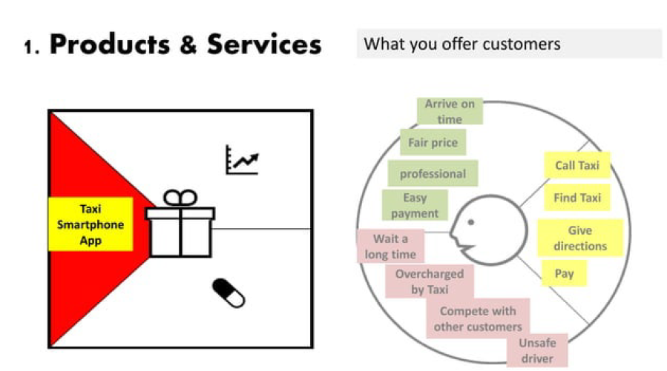
Include all the products and services you are going to deliver. About each one, ask yourself:
Can the product/service help to accomplish any job-to-be-done, whether functional, social, emotional, needs, wishes, roles, etc.?
Is the product/service tangible, digital/virtual, or financial?
Is the product/service crucial or trivial? How relevant is it?
How often is the product/service used by my customer?

Slide 23
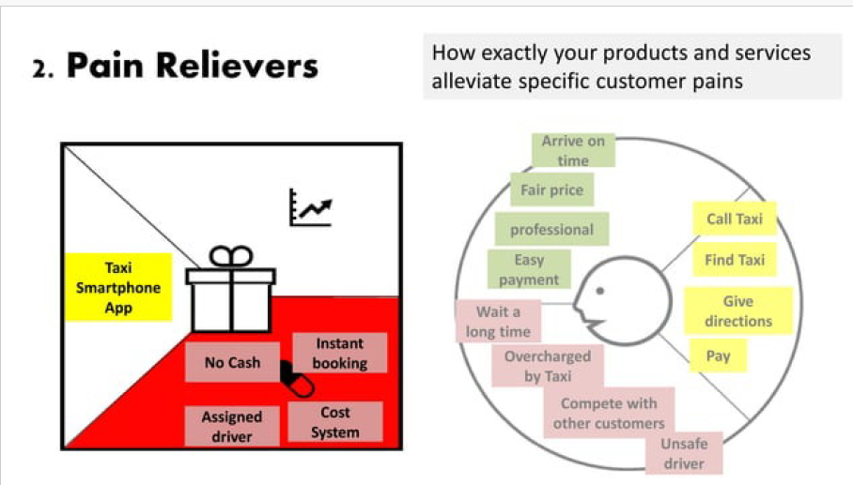
Describe how your product/service relieves the customer’s pains. Identify if you reduce their costs, negative feelings, efforts, risks, negative consequences, mistakes…
To help you out, ask if your product/service:
produces savings (in terms of time, money, effort, etc.);
makes your customer feel better (they end up with frustrations, discomforts, things that give headaches, etc.);

Slide 24
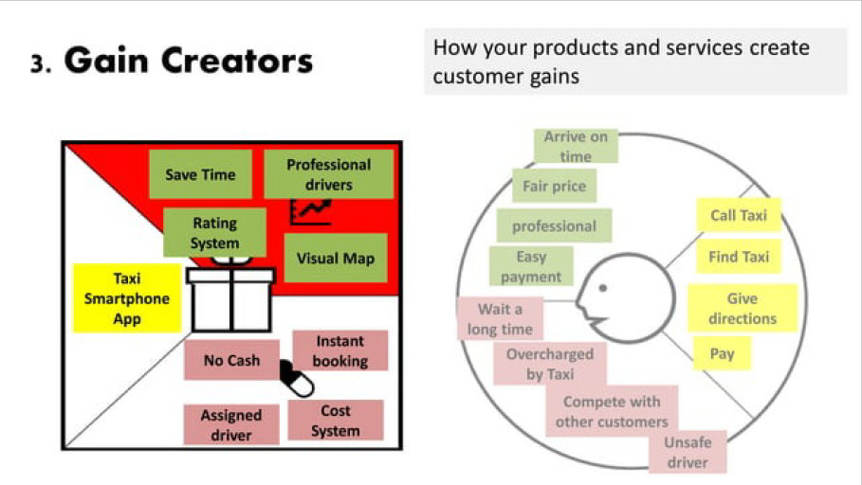
Involve how the product/service offers the customer added value, what are the benefits your product brings, and if your customer’s wishes and expectations are reached. After all, how it makes your customer happier.
To do that, ask if your product/service:
creates savings that make your customer happy (in terms of time, money, effort, etc.);
produces results that your customer expects or that goes beyond their expectations (better level of quality, more of something, less of another);

Slide 25
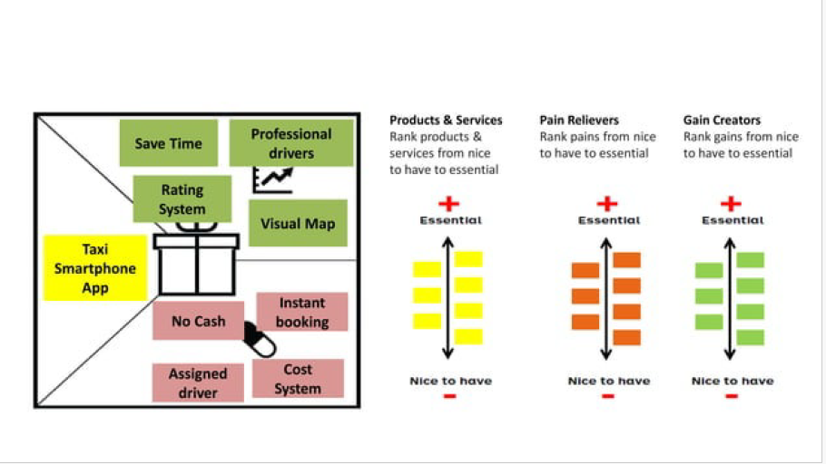

Slide 26
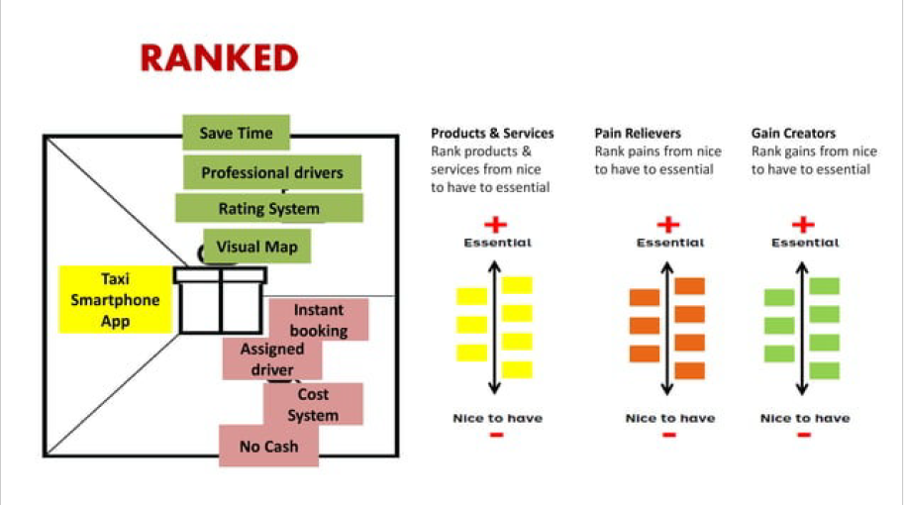

Slide 27
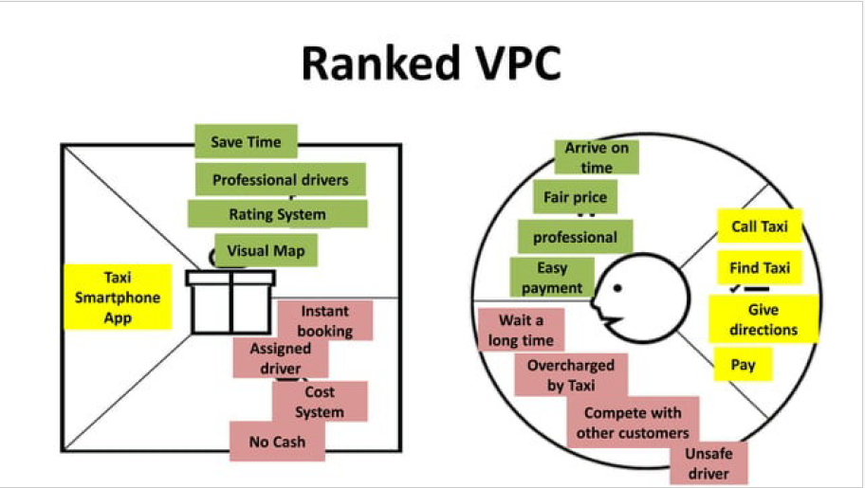

Slide 28
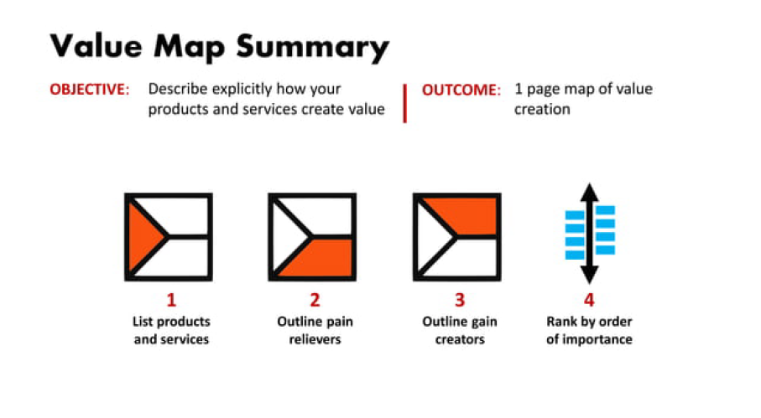

Slide 29
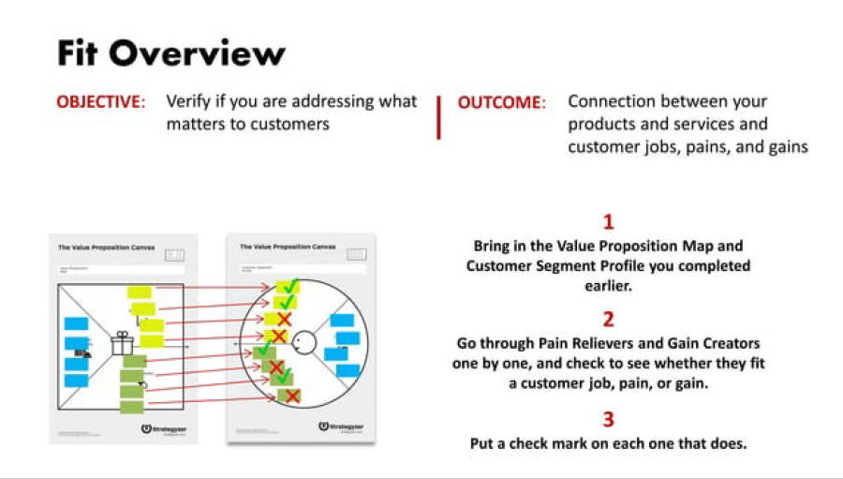

Slide 30
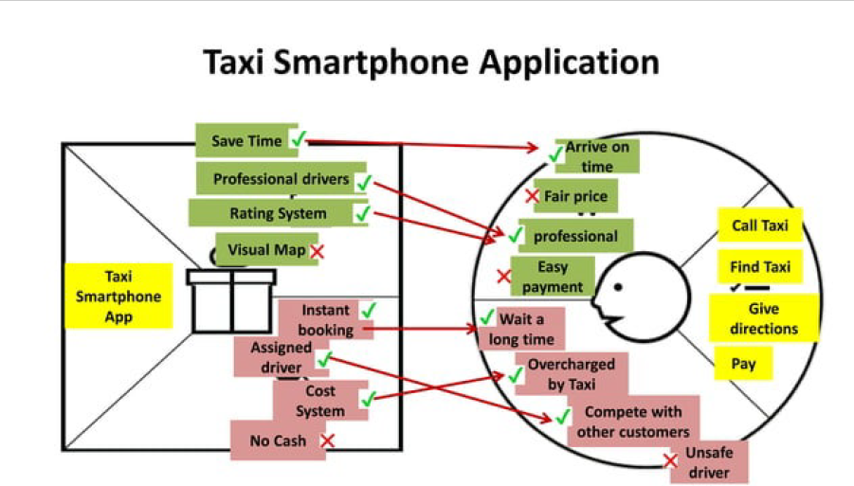

Slide 31
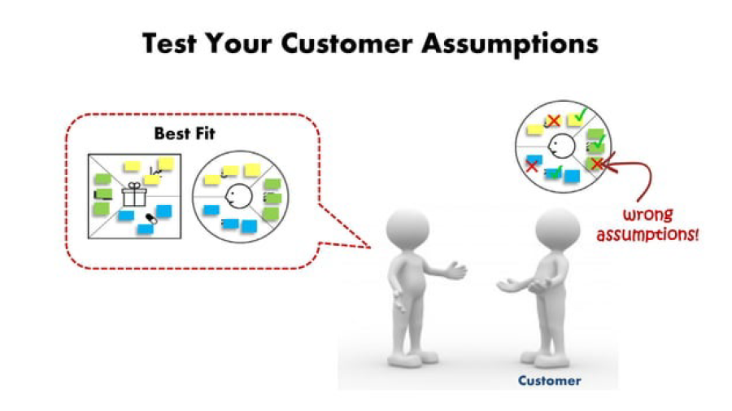

Slide 32
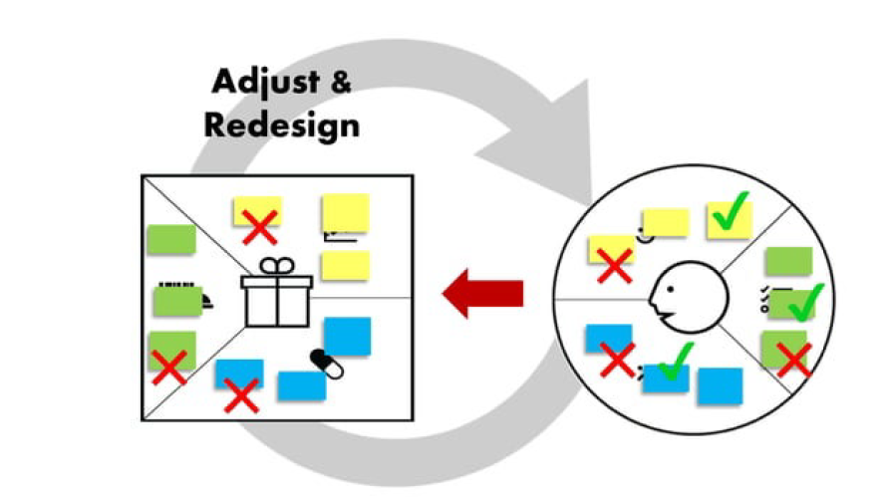

Slide 33
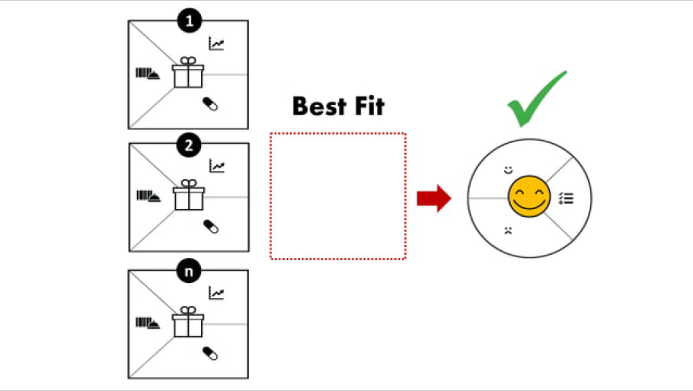

Slide 34
